Slide 1
The Burning
City
Dhaka
Presented by
MD. SAZZADUL ISLAM SHAON
ID : 0242310005101028
Section : 64_B

Slide 2
Course Details
Course Tutor
Course Title : Art of Living
Course code : AOL 101
Mr. Abdullah Al Mamun
Lecturer
Department of CSE
Daffodil International University.

Slide 3
TABLE OF CONTENTS
01
02
03
04
Bailey road tragedy
Cause of deaths
Is this the first time?
Problems and Solutions

Slide 4
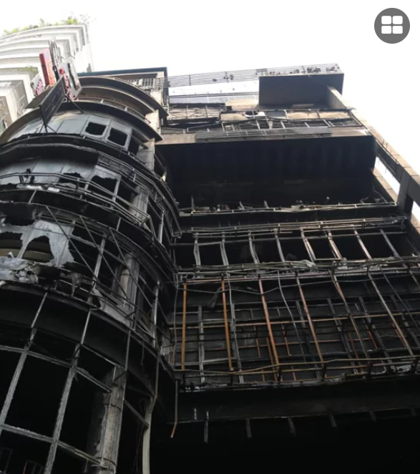
Bailey Road Tragedy
On February 29th, 2024
At 10 PM
Building named ‘Green Cozy Cottage’
44 Killed including 26 women and 3 babies
22 critically injured
Fire started spreading from a restaurant named ‘Chumuk’
Source : The Daily Star

Slide 5
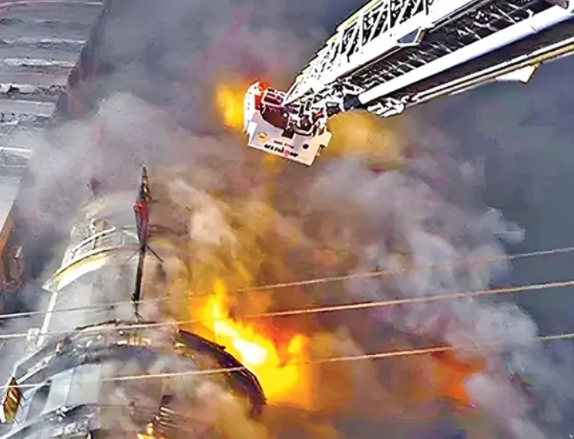
Cause of deaths
Hospital sources say that most of the dead persons do not have marks of any burn injuries. Some do have burn marks, but not that serious.
Physicians say that the reason of the deaths is carbon monoxide poisoning.
Injured persons were in closed spaces filled with black fumes for around half an hour to 45 minute

Slide 6
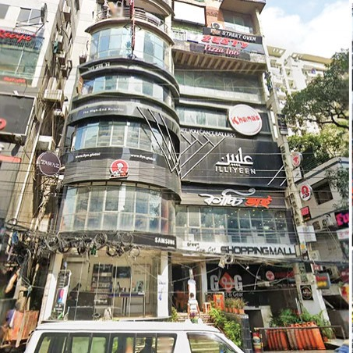
Reasons?
Lack of emergency exit
Unorganized gas cylinder
Closed environment
Mismanagement

Slide 7
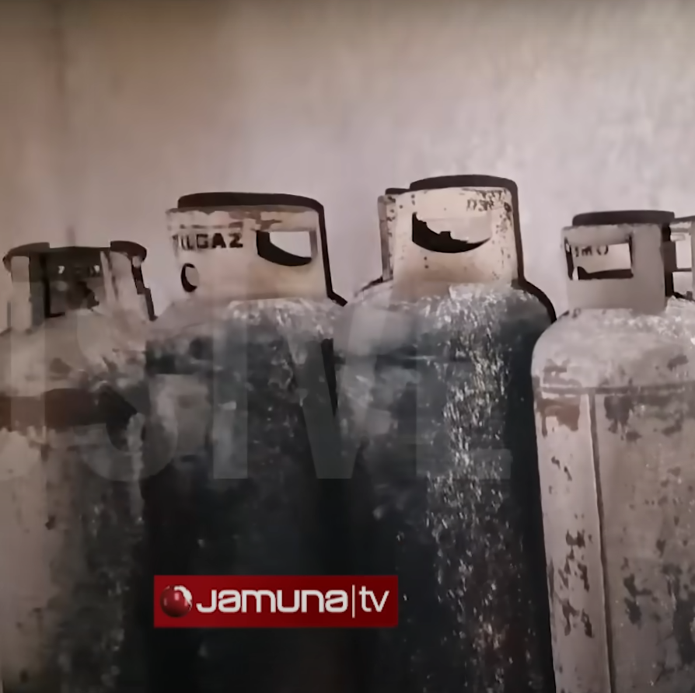
Reasons?
Lack of emergency exit
Unorganized gas cylinder
Closed environment
Mismanagement

Slide 8
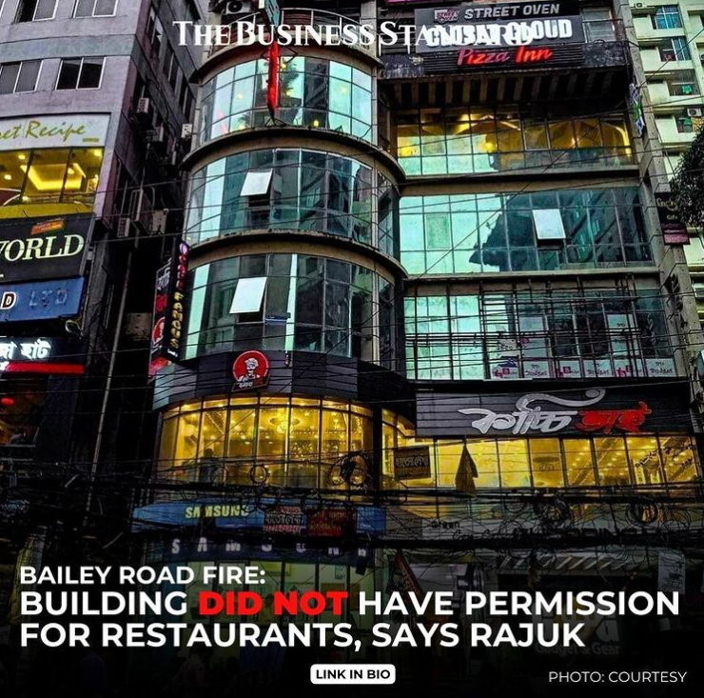
Reasons?
Lack of emergency exit
Unorganized gas cylinder
Closed environment
Mismanagement

Slide 9
Reasons?
Lack of emergency exit
Unorganized gas cylinder
Closed environment
Mismanagement

Slide 10
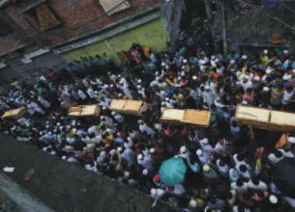
Is this the first time?
On June 3, 2010
Chemical warehouse, Nimtoli , Old Dhaka
124 Deaths

Slide 11
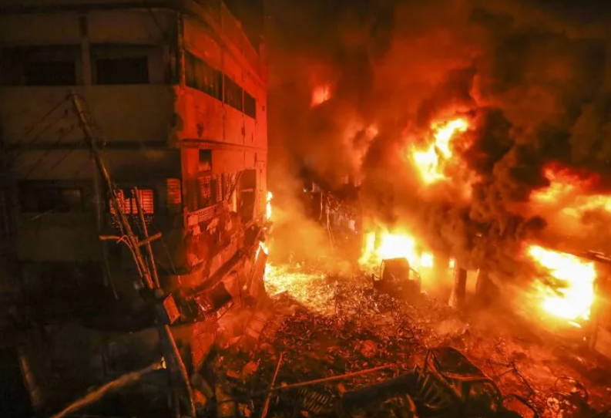
Is this the first time?
On February 20, 2019
Chawkbazar , Old Dhaka
80 Deaths

Slide 12
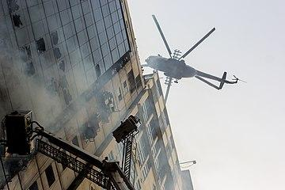
Is this the first time?
On March 28, 2019
FR Tower, Banani , Dhaka
27 Deaths

Slide 13
Problems
We know Dhaka is one of the most dense city in the world. Around 23.9 Million people live in Dhaka. To make rooms for these amount of people everyday new multiple stories buildings are being made. Most of them don’t have permissions or follow proper guidelines. Still they manage to stay untouched by the authority .
And for that reason we are witnessing these kind of tragedy killing dozens of people day after day.

Slide 14
Solutions
Authority have to be more strict.
Separate commercial and Residential area
Regular inspections of the buildings
Check every safety features in buildings
Proper city planning

Slide 15
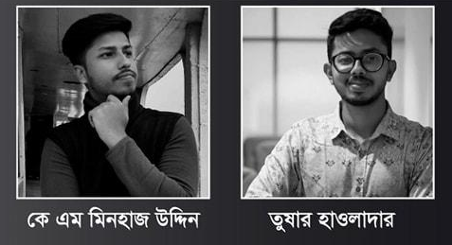

Slide 16
Any Questions?

